Slide 1
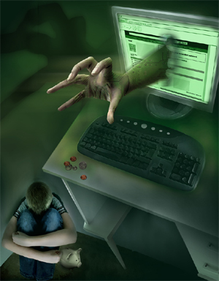
Cyber Bullying
prospects and prevention

Slide 2
What is it?
Cyber bullying is simply the use of any type of technology maliciously and intentionally to hurt someone else. Examples:
  Harassing a person through text messages
  Sending threatening or inappropriate emails
  Posting hurtful messages on an individuals Facebook or twitter
  Making fun of someone in chat rooms
  Making and posting YouTube videos intended to hurt or harass someone

Slide 3
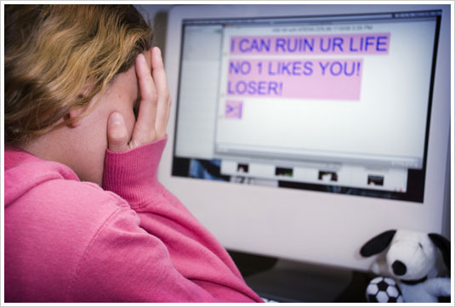
What is it? Cont.
Cyber bullying is typically aimed at younger adolescents and can lead to serious issues such as police involvement, school involvement, and teen suicide

